Slide 1
Coding Dojo Data Science Project 2
Susan Shin: December 2022

Slide 2

Outline
Who is your stakeholder and what problem are you solving for them
A brief introduction to your data
Two visuals that demonstrate key findings of interest to your stakeholder.
Final recommendations based on your analysis.
A brief description of the strengths and limitations of your model for your stakeholder.

Slide 3
Business Problem
The goal of this analysis is to understand what types of attribute contribute to wine ratings.
Some questions we aim to answer are:
Which attributes affect customer ratings
Which attributes have the most sway on a customers rating
Are we able to predict what rating a wine will get based on these attributes

Slide 4
Steak Holders
Restaurants
Wineries
Wine Distributers
Winer Marketers
Winer Buyers
ANYONE WHO WANTS TO UNDERSTAND WINE CONSUMER BEHAVIOR!

Slide 5
Data Introduction
The data we will be using contains consumer ratings for various types of wine.
The data also includes attributes of the wines that were tasted for further understanding of how one might come to their final ratings.
Attributes included in data are:
Winery, Winer, Year, Number of Reviews, Region, Price, Wine Type, Body, and Acidity.
Average ratings range from 4.3 – 4.9.
Sample of data set is included in appendix.
Link to Data Set

Slide 6
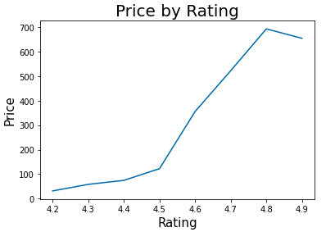
This graph, although simple, shows a strong connection between customer rating and price. As the price of a wine goes up, one can also see the rating increase. Although it’s been argued that the price of wine is arbitrary this graph shows how customer perception of wine is still highly correlated to price.

Slide 7
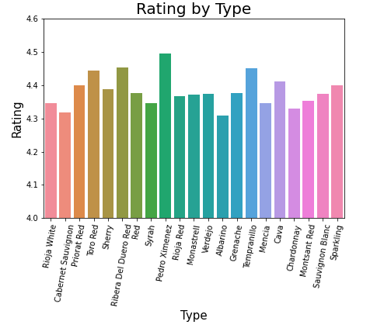
This graph shows rating by wine type. While the type of wine would seem to be the most influential attribute in customer rating, you can see that the average ratings per wine type are relatively close to each other. This graph shows how the type of wine doesn’t have as much influence on rating as one might think.

Slide 8
Strengths & Limitations
Limitations
More information is needed to understand how this data was collected.
Were these ratings taken from a controlled test environment? Or simply from something like a yelp rating?
What is the cross section of people that were sampled?
Do they know a lot about wine or are they average consumers?
What is the cross section of wines that were available to be sampled?
Strengths
We were able to understand what attributes have strong correlations to ratings; such as price and winery.

Slide 9
Final Recommendation
With the models that were chosen we were able to get a 52% accuracy rate.
While this is not ideal, the data does help steak holders understand what types of attributes sway a consumer’s rating.
Recommendation would be for those that want to receive a higher rating, focus on price for the time being.
However, the recommendation would be to dig deeper into the data set and consider using a different type of model to see if we can get a more accurate prediction moving forward.

Slide 10
APPENDIX

Slide 11
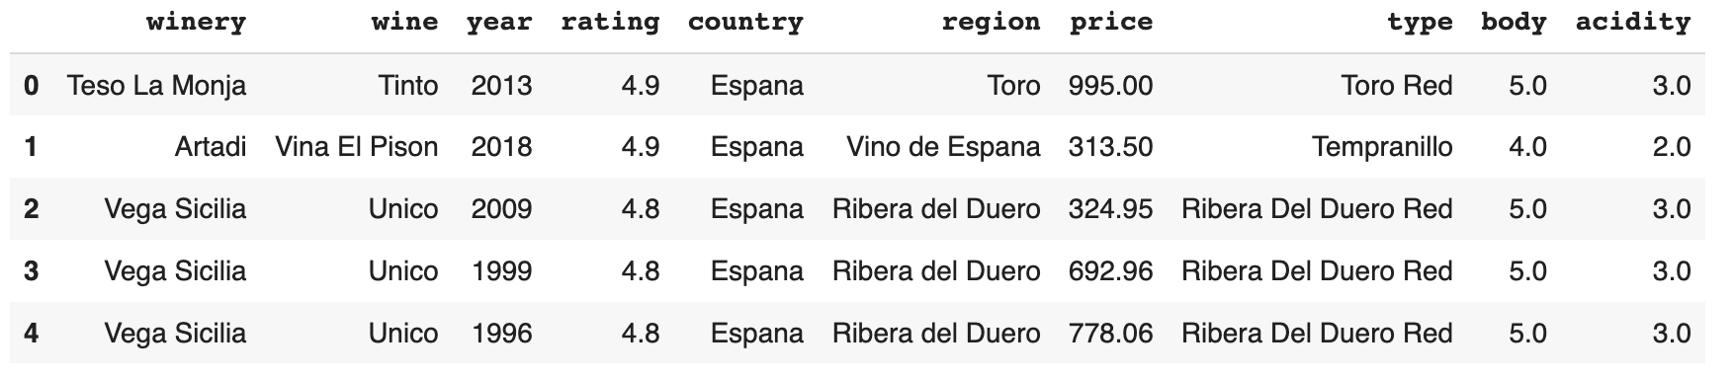
Sample of Data

Slide 12

Links
Github Repository
Collab notebook

